Slide 1



MEDPro v2.0.0
JT22 Consulting

Slide 2
agenda
Introduction
Opportunities for growth
Enter MedPro
Key features
Presentation
Key value add
Next steps
Open Q/A

Slide 3

Meet Jt22
Jhordan Howard
Project Manager
Business Analyst
Technical Analyst
Quality Analyst
Client Engagement Manager

Slide 4
Mission Statement
Our mission is to provide innovative, unique solutions to the technical challenges that our clients face today. We assist businesses in becoming their best selves as they adapt to the world’s ever-evolving challenges. Because no two businesses are the same, and neither are their challenges, we pride ourselves on exceptionally personalized service to ensure that we give each client what is truly best for them.

Slide 5
The Deciding Factors
Resource Allocation
Project Management

Slide 6

The million-dollar question……
WHERE do you put WHO to do WHAT?

Slide 7
Leading an industry
Largest private medical manufacturer and distributor
#1 Market Leader
Surgery centers
Home care agencies
Acute care facilities
95% Customer retention rate
50+ Years of consecutive growth
125+ Countries
“We Make Healthcare Run BETTER”

Slide 8

Growth opportunities
Project Management
Resource Allocation
Time Management

Slide 9
Enter Medpro
Resource Skills and Proficiencies
Projects (current and upcoming)
Availability

Slide 10
Presentation
Resource Profile
Manager Profile
Planner Profile
Admin Profile

Slide 11
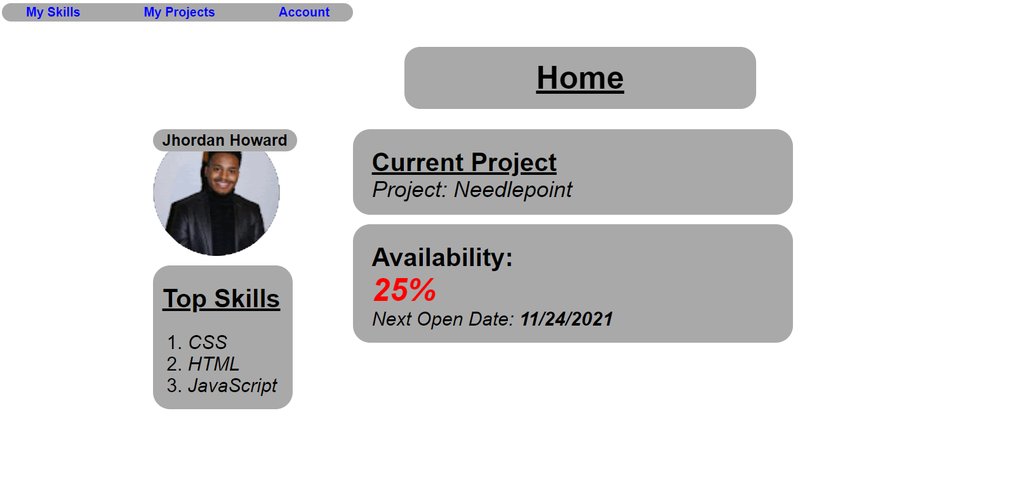
Resource profile (Home page)

Slide 12
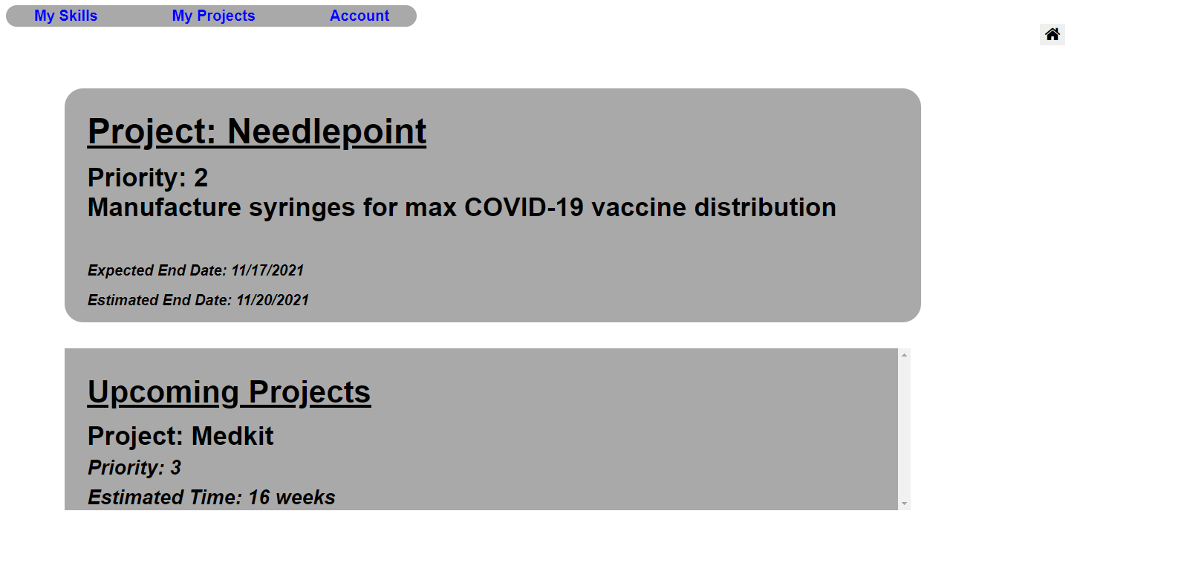
Resource profile (Projects)

Slide 13
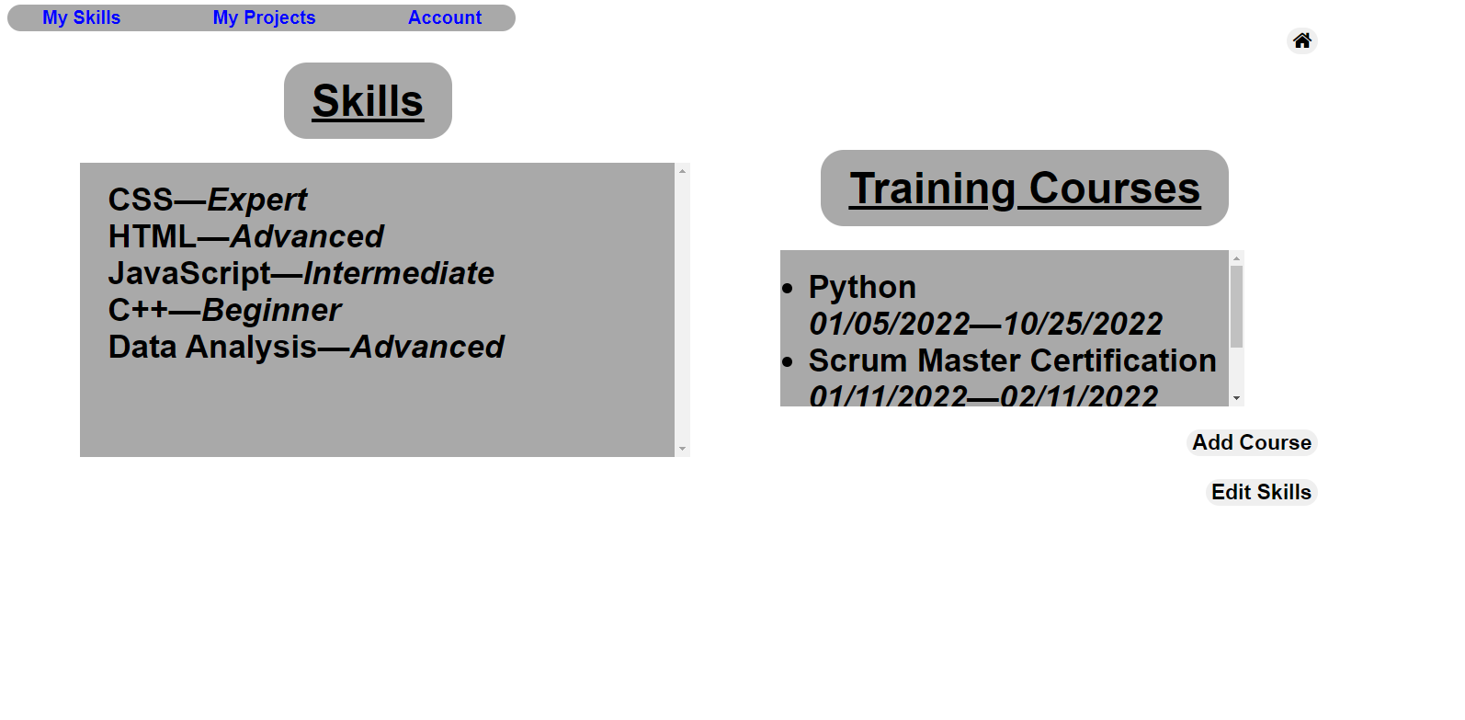
Resource profile (skills)

Slide 14
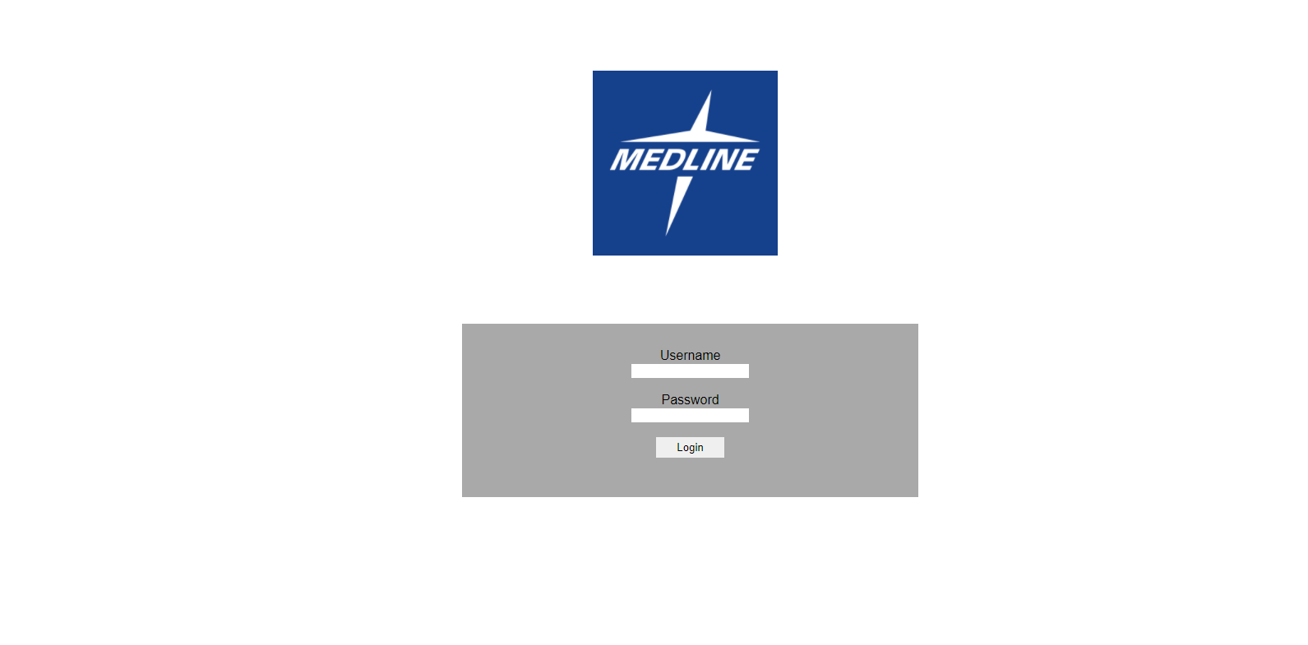
Manager Profile

Slide 15
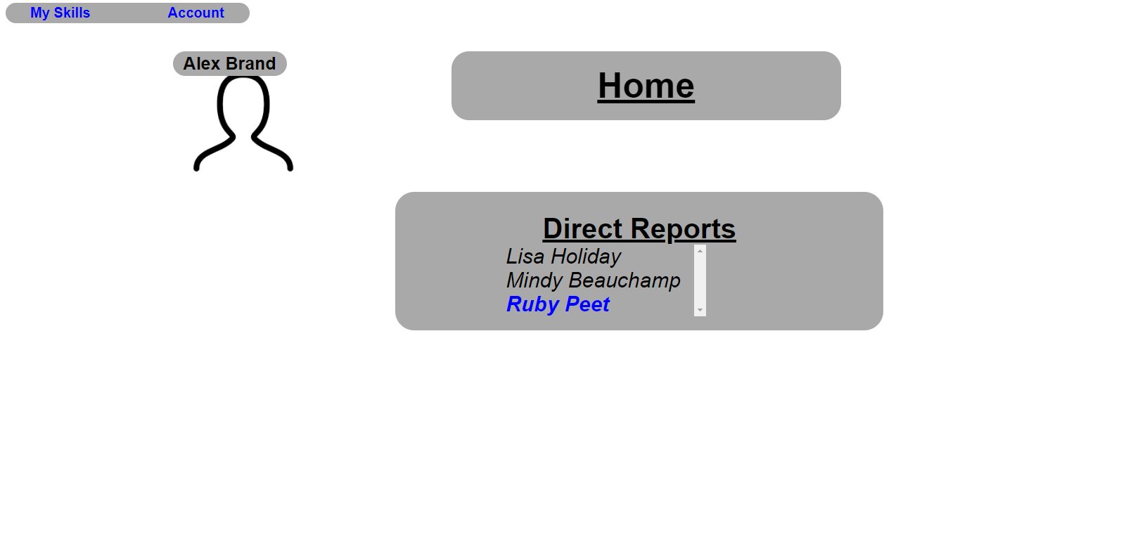
manager profile (Home page)

Slide 16
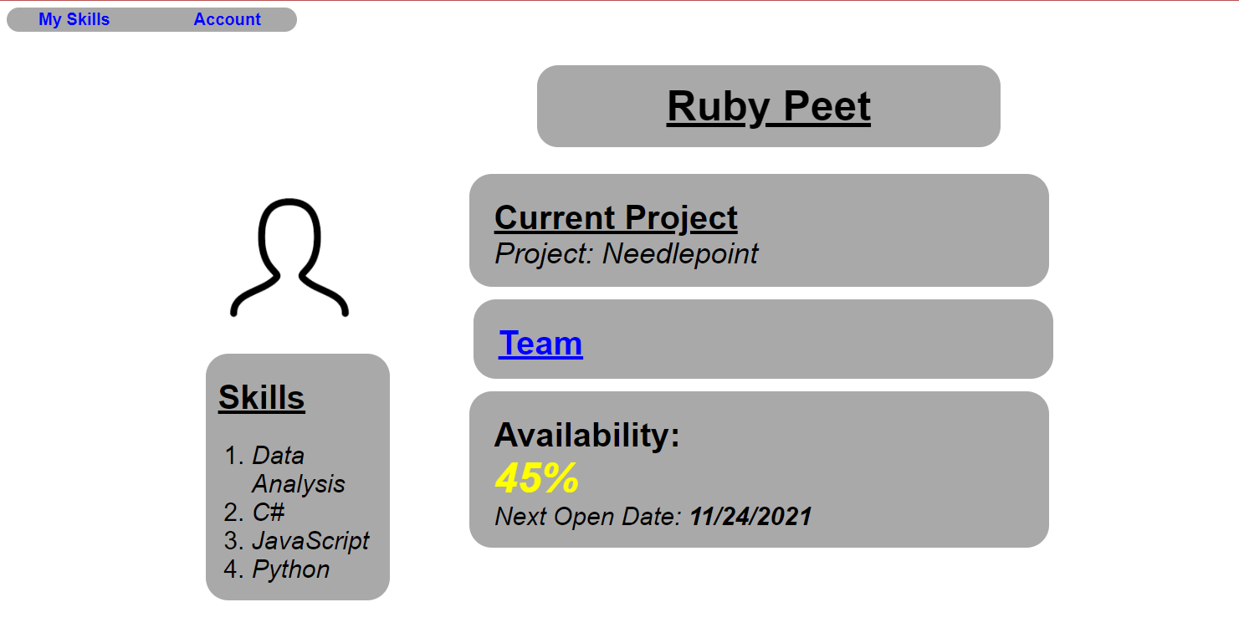
Manager Profile (Direct Reports)

Slide 17
Bringing the value
↑Efficiency in project management
Optimized resource allocation
Synchronized management processes

Slide 18
Next steps
Deployment Date: 2/14/2021
Possible Future Features
Verification Processes (Skill configuration, resource allocation, etc.)
Holistic priority metrics
In-app communication

Slide 19

Thank YOU!

Slide 20
Open Q/A

